Slide 1
Error detection

Slide 2
Error
Data are transmitted in several network setups from one device to another
Might be corrupted during transmission
Transmission error
For reliable communication, errors must be detected and corrected
It happens in Transport Layer and Data link layer of OSI model

Slide 3
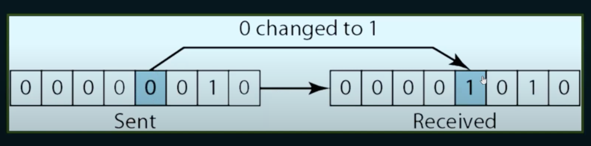
Types of errors: Single bit error
Sender sends 00000010 (2) , receiver receives 00001010 (4)
Long distance attenuation, natural causes- lighting , machine error

Slide 4
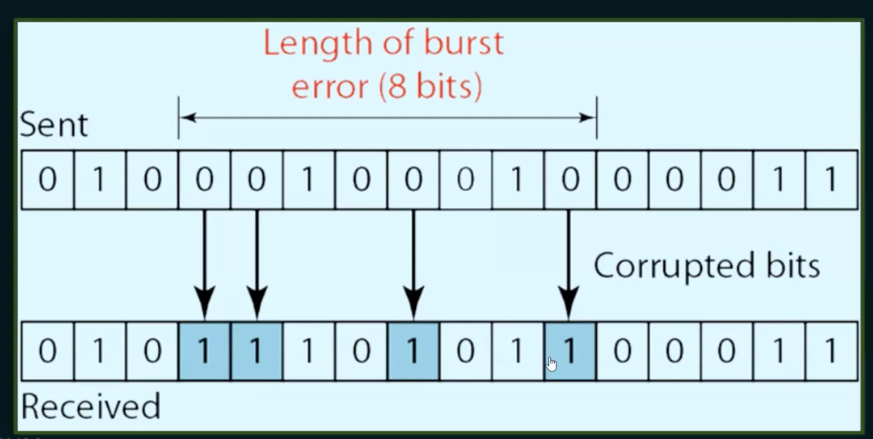
Burst error
More than one bit is changed
101010---------111011 change in 2 bits or more
length of the error 5 bits
Another example:

Slide 5
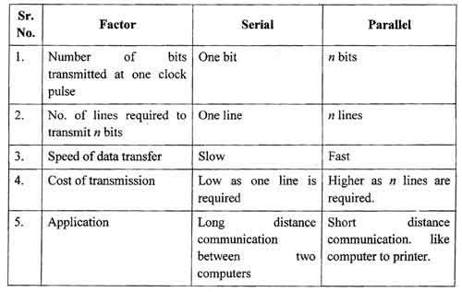
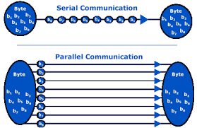
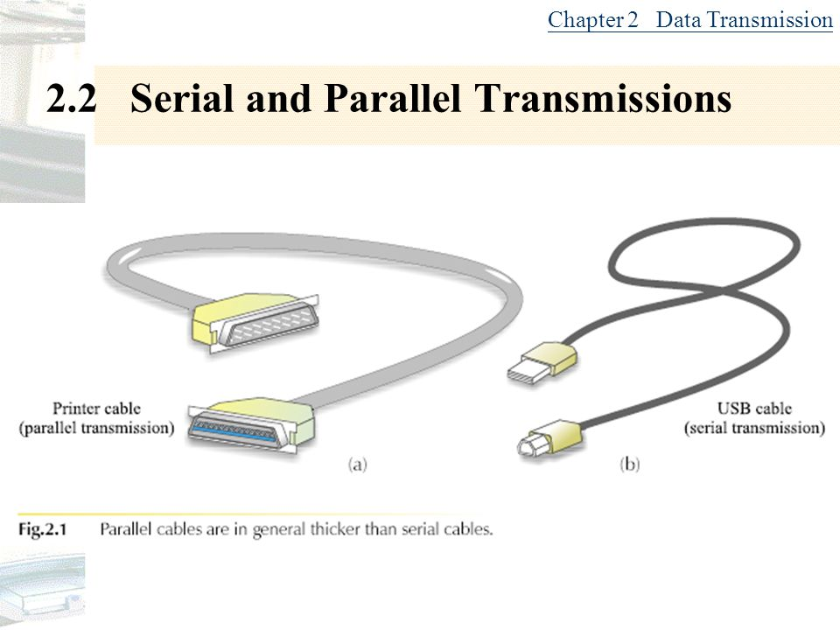
Side notes

Slide 6
Both serial and parallel transmissions have advantages and disadvantages.
Parallel transmission is used for shorter distances and provides greater speed, while serial transmission is reliable for transferring data over longer distances.
Both serial and parallel transmissions are individually essential for transferring data.

Slide 7
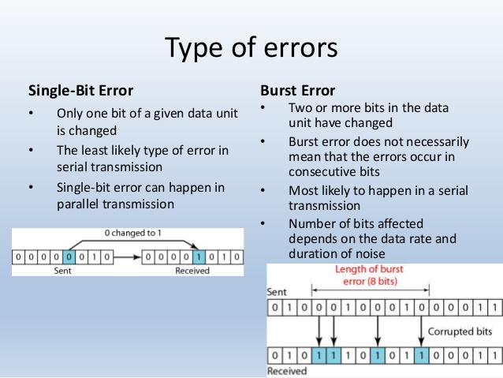
Difference

Slide 8
How to detect errors
Error detection means to decide whether the received data is correct or not without having a copy of the original message
If only data is transmitted, errors cannot be detected
Send more information with data that satisfies a special relationship
The extra bits are called redundant bits

Slide 9
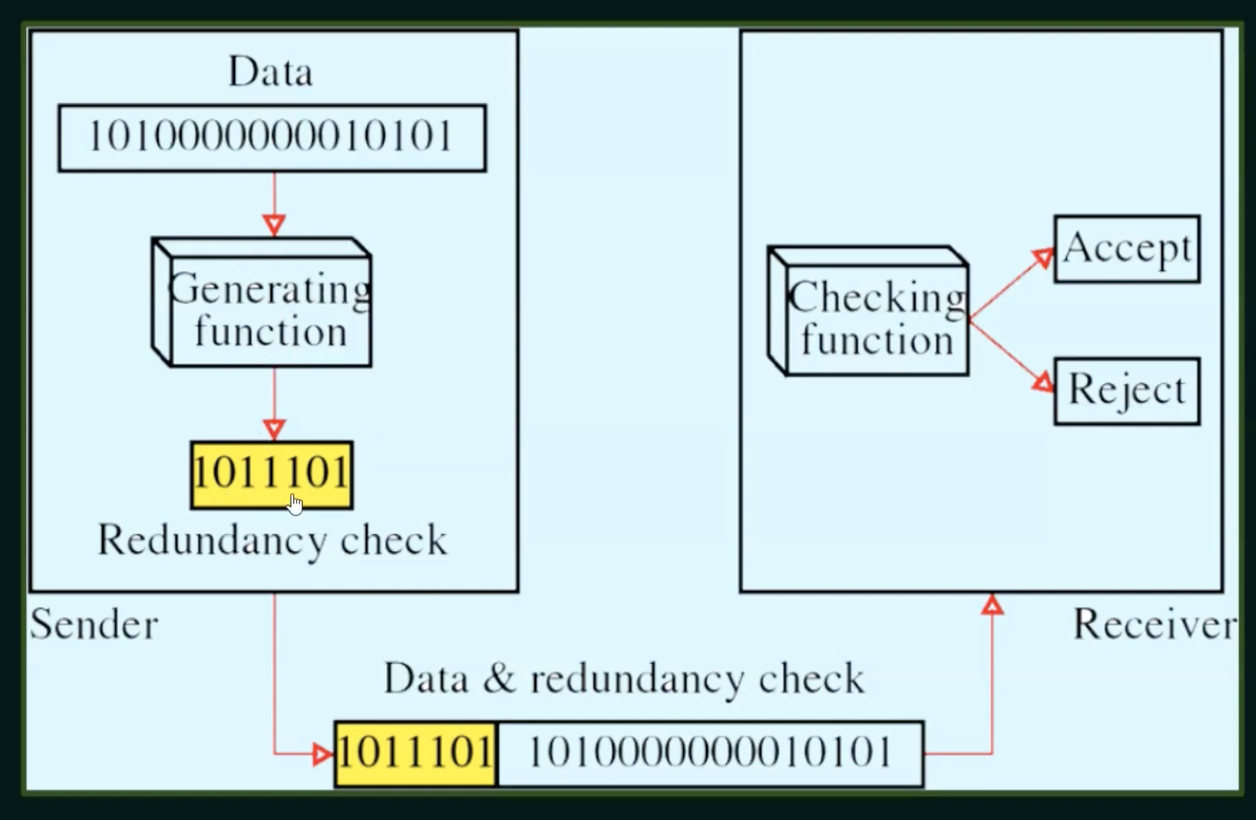
Redundancy flowchart

Slide 10
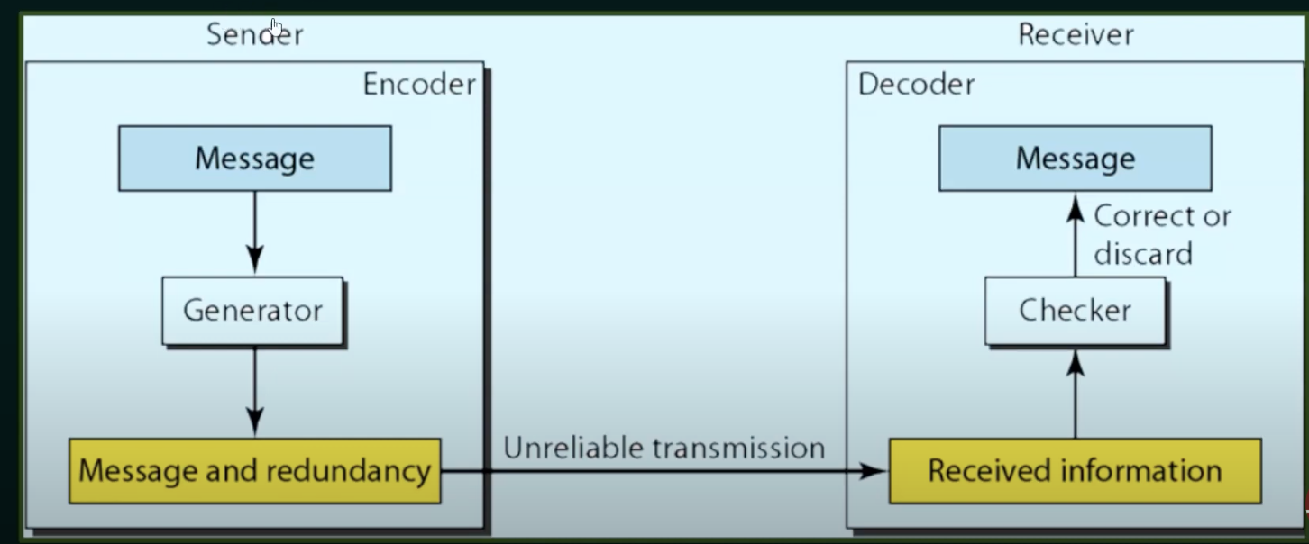
Error detection steps

Slide 11
What is parity
Concept to detect errors
Even parity= number of 1’s should be even
Odd parity = number of 1’s should be odd
Example of even parity | Example of odd parity
100 1 101 0 110 0 111 1 | 000 1 001 0 010 0 011 1

Slide 12
Test=even/odd
1110110
1101111
1110010

Slide 13
Error Detection methods
Detection
Virtical Redundancy check (VRC)
Longitudinal Redundancy check (LRC)
Checksum
CRC

Slide 14
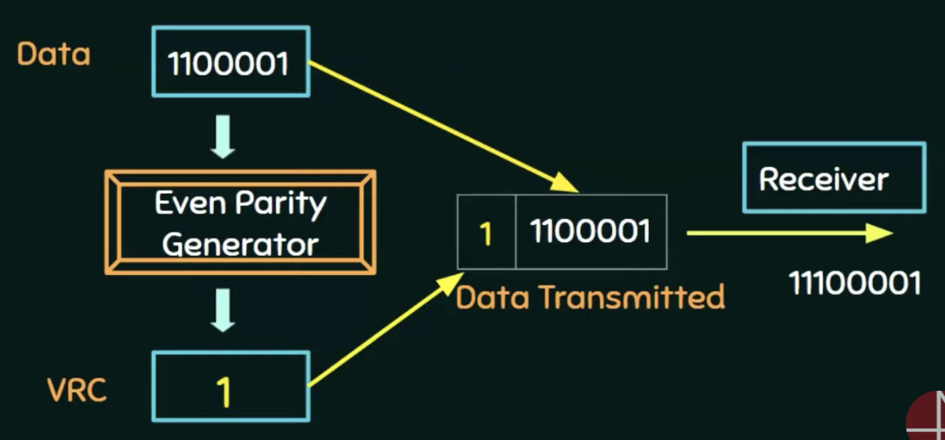
Single parity –simple method +least expensive
VRC (Vertical redundancy check) / Parity check
Want to send more data, less redundant bits
m+1 bits (m=message bits)
Even parity no of 1 s should be even
1010 0
1110 1
It can detect all single bit errors in code words
11101 is changed 01101 It can detect but can't correct
Can detect burst errors only if the number of errors is odd
11101---00101 can not detect

Slide 15
LRC :Longitudinal redundancy check
In LRC a block of bits is organized in rows and columns
A.K.A= Two dimensional parity
The parity bit is calculated for each column and sent along with the data
The block of parity acts as the redundant bits

Slide 16
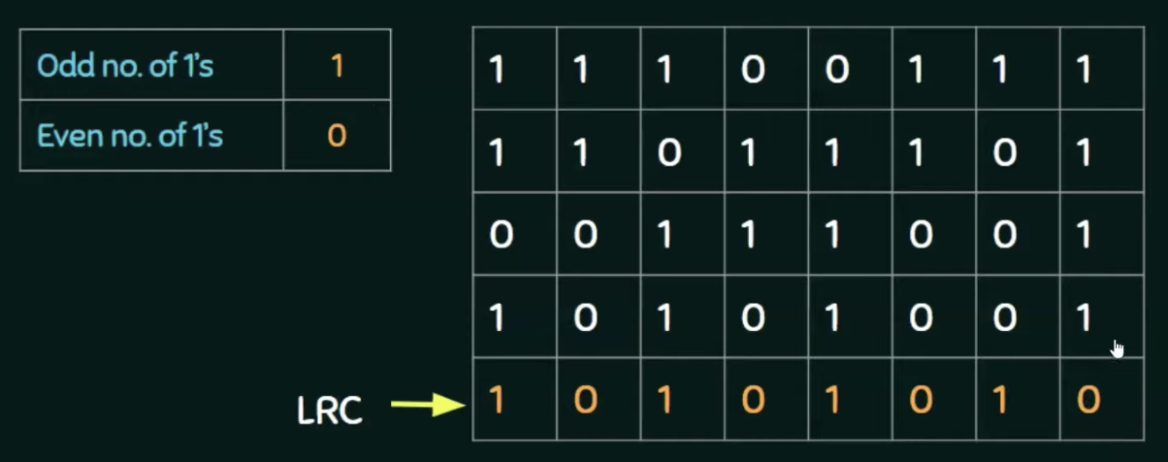
LRC -example
Find the LRC for the data blocks 10101001 00111001 11011101 11100111 and determine the data that is transmitted.

Slide 17
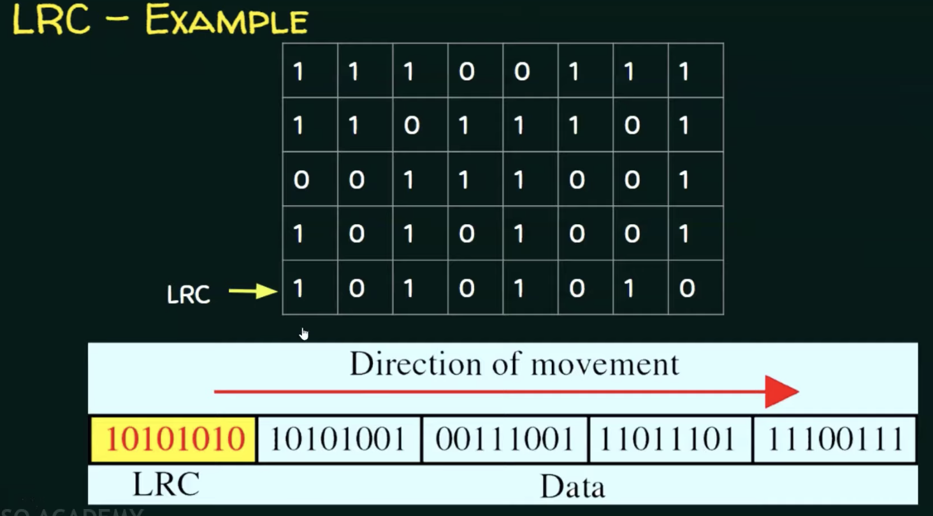

Slide 18
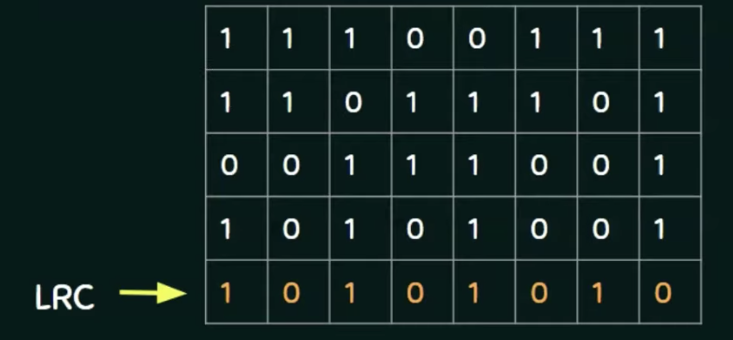
PERFORMANCE OF LRC
INCREASES THE LIKELIHOOD OF DETECTING BURST ERRORS
IF 2 BITS IN ONE DATA UNIT ARE DAMAGED AND 2 BITS ARE EXACTLY IN THE SAME POSITION IN ANOTHER DATA UNIT ARE ALSO DAMAGED , LRC CHECKER WILL NOT BE ABLE TO DETECT THE ERROR

Slide 19
CHECKSUM
Checksum=check+sum
Sender side= creation
Reciever side = validation

Slide 20
Operation at sender side
Break the original message into ‘k’ number of blocks with ‘n’ bits in each block
Sum all the k data blocks
Add the carry to the sum, if any
Do 1’s complement to the sum

Slide 21
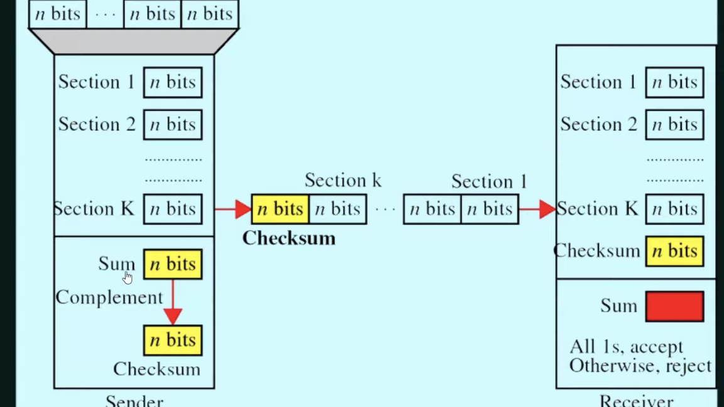

Slide 22
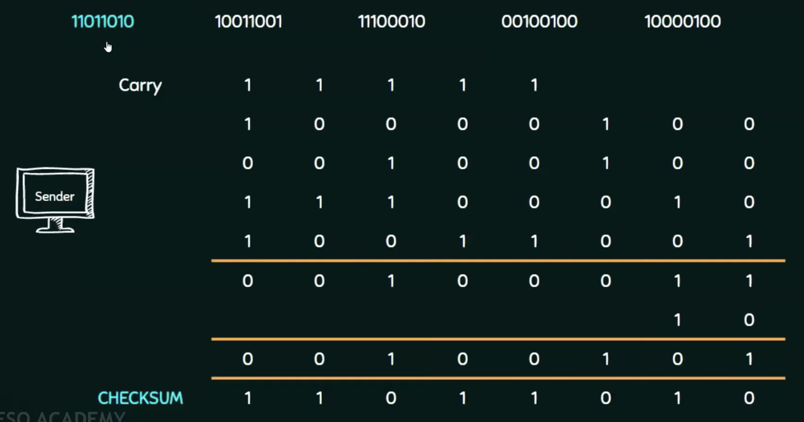
CONSIDER THE DATA UNIT TO BE TRANSMITTED 10011001111000100010010010000100 10011001 11100010 00100100 10000100

Slide 23
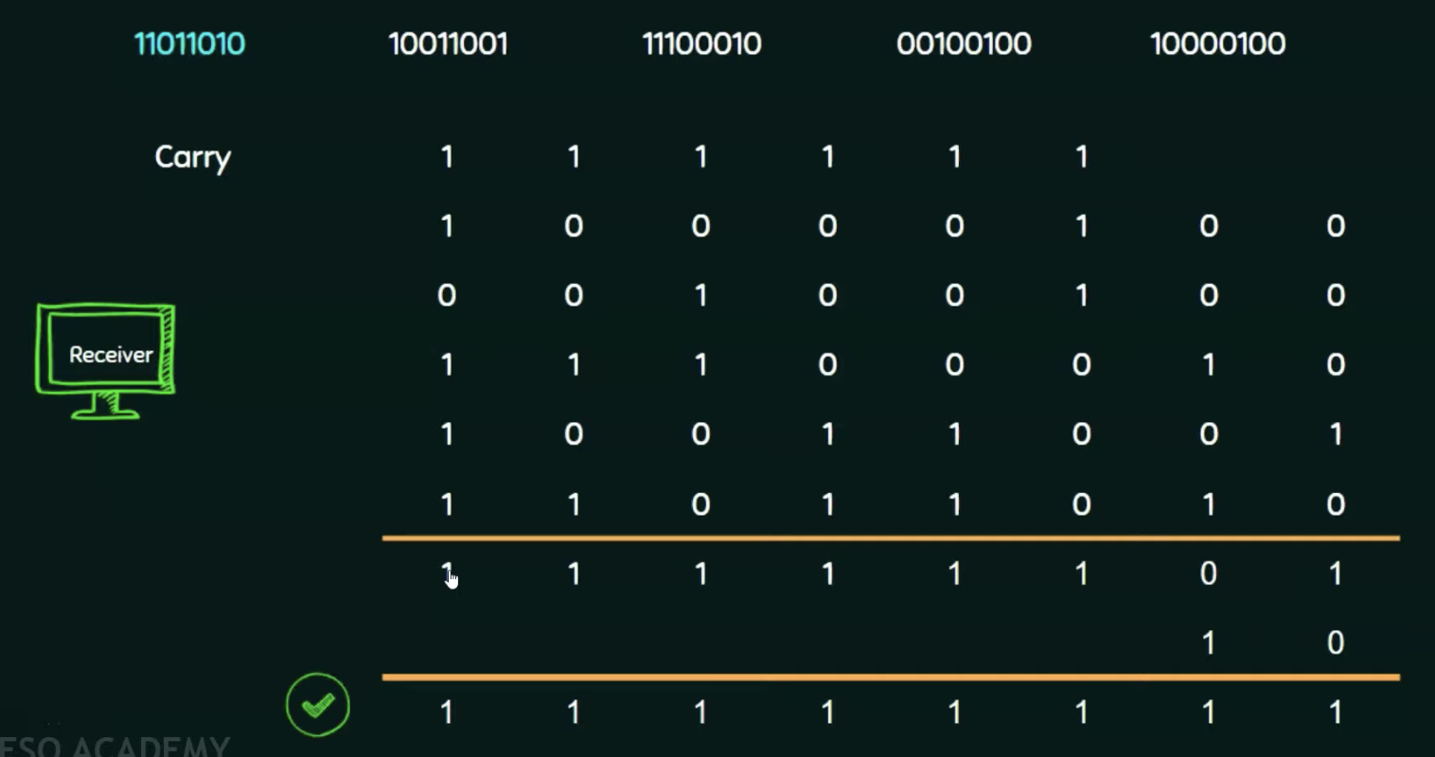
Operation at reciever side
Collect all the data blocks inculiding the cheksum
Sum all the data blocks and checksum
If the result is all 1’s ACCEPT., ELSE , REJECT

Slide 24
Performance
Detects all errors involving an odd number of bits
It detects most errors involving an even number of bits

